Slide 1
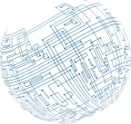



Type of
Attack Indicators

Slide 2
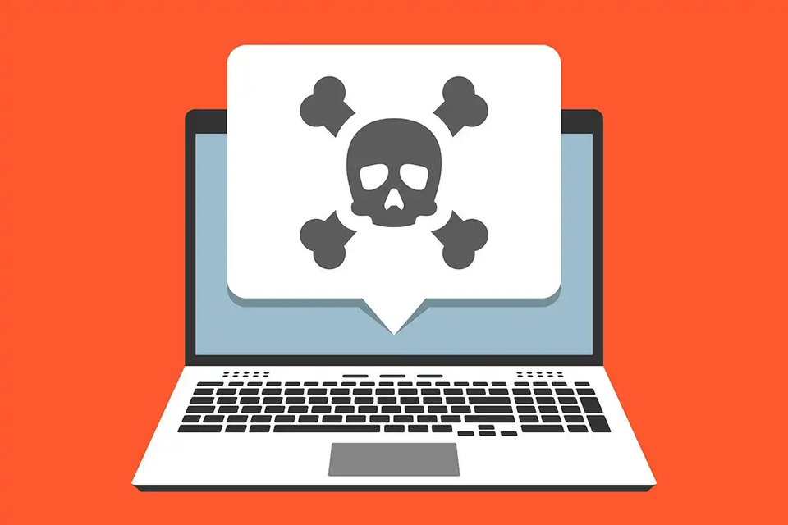
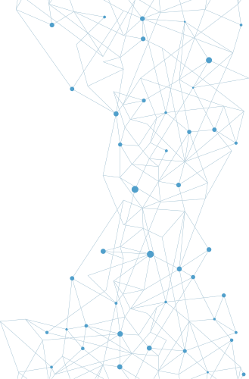
Malware
Malware describes a wide range of software that is intentionally designed to cause harm to systems and devices, networks, or users. Malware can also gather information, provide illicit access, and take a broad range of actions that the legitimate owner of a system or network may not want to occur.

Slide 3

Ransomware
Ransomware is malware that takes over a computer and then demands a ransom.
Crypto malware is a ransomware which encrypts files and then holds them hostage until a ransom is paid.

Slide 4

Trojans
Trojans, or Trojan horses, are a type of malware that is typically disguised as legitimate software. They are called Trojan horses because they rely on unsuspecting individuals running them, thus providing attackers with a path into a system or device
Remote access Trojans (RATs) provide attackers with remote access to systems.

Slide 5
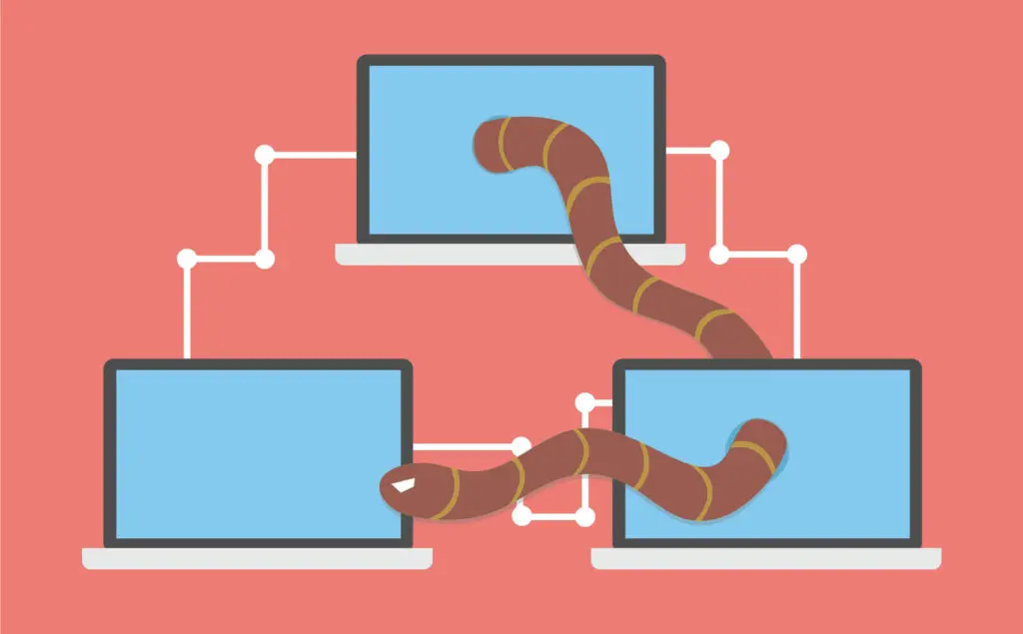
Worms
Worm spreads from system to system without any user interaction. Although worms are often associated with spreading via attacks on vulnerable services, any type of spread through automated means is possible, meaning that worms can spread via email attachments, network file shares, or other methods as well. Worms also self-install, rather than requiring users to click on them, making them quite dangerous.

Slide 6
Rootkits
Rootkits are malware that is specifically designed to allow attackers to access a system through a backdoor. Many modern rootkits also include capabilities that work to conceal the rootkit from detection through any of a variety of techniques, ranging from leveraging filesystem drivers to ensure that users cannot see the rootkit files, to infecting startup code in the master boot record (MBR) of a disk, thus allowing attacks against full-disk encryption systems.

Slide 7
Backdoors
Backdoors are methods or tools that provide access that bypasses normal authentication and authorization procedures, allowing attackers access to systems, devices, or applications.

Slide 8
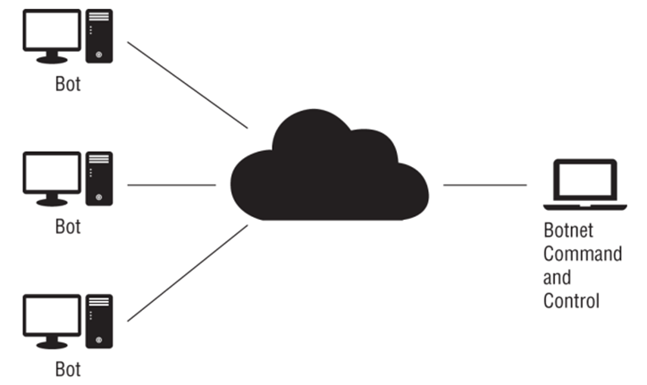
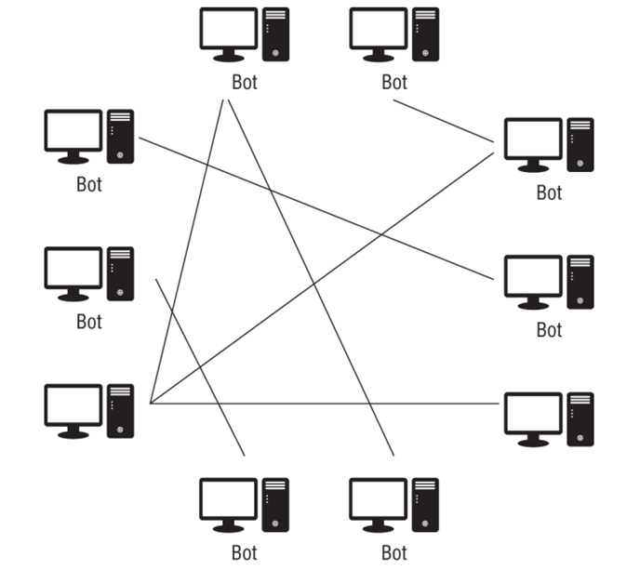
Bots
Bots are remotely controlled systems or devices that have a malware infection. Groups of bots are known as botnets, and botnets are used by attackers who control them to perform various actions, ranging from additional compromises and infection, to denial-of-service attacks or acting as spam relays.

Slide 9
Keyloggers
Keyloggers are programs that capture keystrokes from keyboards, although keylogger applications may also capture other input like mouse movement, touchscreen inputs, or credit card swipes from attached devices. Keyloggers work in a multitude of ways, ranging from tools that capture data from the kernel, to APIs or scripts, or even directly from memory.

Slide 10
Logic Bombs
Logic Bombs are functions or code that are placed inside other programs that will activate when set conditions are met. Some malware uses this type of code to activate when a specific date or set of conditions is met.

Slide 11
Viruses
Computer viruses are malicious programs that self-copy and selfreplicate. Viruses require one or more infection mechanisms that they use to spread themselves, typically paired with some form of search capability to find new places to spread to. Viruses also typically have both a trigger, which sets the conditions for when the virus will execute, and a payload, which is what the virus does, delivers, or the actions it performs.

Slide 12
Virus
Sources
Memory-resident viruses, which remain in memory while the system of device is running
01.
Non-memory-resident viruses, which execute, spread, and then shut down
02.
Boot sector viruses, which reside inside the boot sector of a drive or storage media
03.
Macro viruses, which use macros or code inside word processing software or other tools to spread
04.
Email viruses, which spread via email either as attachments or as part of the email itself using flaws within email clients
05.

Slide 13
Viruses
File viruses spread via methods like spam email and malicious websites, and they exploit flaws in browser plug-ins and web browsers themselves. Once they successfully find a way into a system, they inject themselves into memory and conduct further malicious activity, including adding the ability to reinfect the system by the same process at reboot through a registry entry or other technique.

Slide 14
Spyware
Spyware is malware that is designed to obtain information about an individual, organization, or system.

Slide 15
PUP
Potentially unwanted programs (PUPs) are programs that may not be wanted by the user but are not as dangerous as other types of malware. PUPs are typically installed without the user's awareness or as part of a software bundle or other installation.

Slide 16
Spraying
Password spraying is an attack that uses a limited number of commonly used passwords and applies them to a large number of accounts.

Slide 17
Dictionary Attack
Dictionary attack is the method of determining passwords is to use a password-cracking program that uses a list of dictionary words to try to guess the password.

Slide 18
Brute Force Attack
Brute force attack is using a password-cracking program attempts all possible password combinations

Slide 19
Rainbow Tables
Rainbow tables are precomputed tables or hash values associated with passwords. Using rainbow tables can change the search for a password from a computational problem to a lookup problem.

Slide 20
Plaintext Password Attacks
Plaintext password attacks happens when a password is stored as plain readable and unencrypted strings.

Slide 21
Malicious USB Cable
Malicious Universal Serial Bus (USB) Cable. Most users view a USB cable as just a wire, but in fact a USB cable can have embedded electronics in it. “Poisoned” cables have been found with electronics that can deliver malware to machines

Slide 22
Malicious Flash Drives
Malicious Flash Drives. These are malicious USB storage devices that are autorun or autoplay feature.

Slide 23
Card Cloning
Card Cloning. Copying the information on a magnetic strip or a chip and cloning to a different card.

Slide 24
Skimming
Skimming. Using a device that intercepts a card. Attached to card readers to skim data from the card then passing on to a legitimate reader.

Slide 25
Adversarial AI
Adversarial AI uses AI to enable attacks to avoid machine detection.

Slide 26
Tainted Training Data for ML
Tainted Training Data for Machine Learning. ML works by using a training data set to calibrate the detection model to enable detection on sample data. One of the weaknesses of ML is this training set dependency. Tainting the training data is one of the attack vectors that attackers can use against ML systems.

Slide 27
Supply Chain Attacks
Supply-Chain attacks. Supply chains are the network of suppliers that provide the materials for something to be built. Supply chains can have vulnerabilities that can be used by attacker to instantiate the attack vector.

Slide 28
Cloud and On-Premise Attacks
Cloud-based attacks. Attacks against could-base systems
On-premise attacks. Attacks against in-house systems.

Slide 29
Birthday Attacks
Birthday attack is a special type of brute force attack that gets its name from something known as the birthday paradox, which states that in a group of at least 23 people, the chance that two individuals will have the same birthday is greater than 50 percent.

Slide 30
Collision Attacks
A collision attack is where two different inputs yield the same output of a hash function. Through the manipulation of data, subtle changes are made that are not visible to the user yet create different versions of a digital file.

Slide 31
Downgrade Attacks
In a downgrade attack, the attacker takes advantage of a commonly employed principle to support backward compatibility, to downgrade the security to a lower or nonexistent state.

Slide 32
Thank
You

